Slide 1
World Food Explorer
Jonathan Liu

Slide 2

Love Traveling
Love Food Shopping
Non-Multilingual

Slide 3

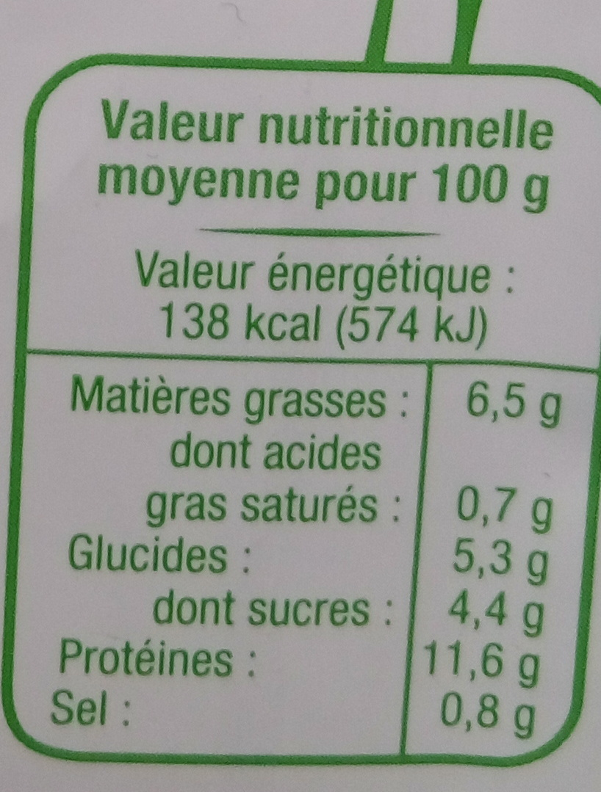
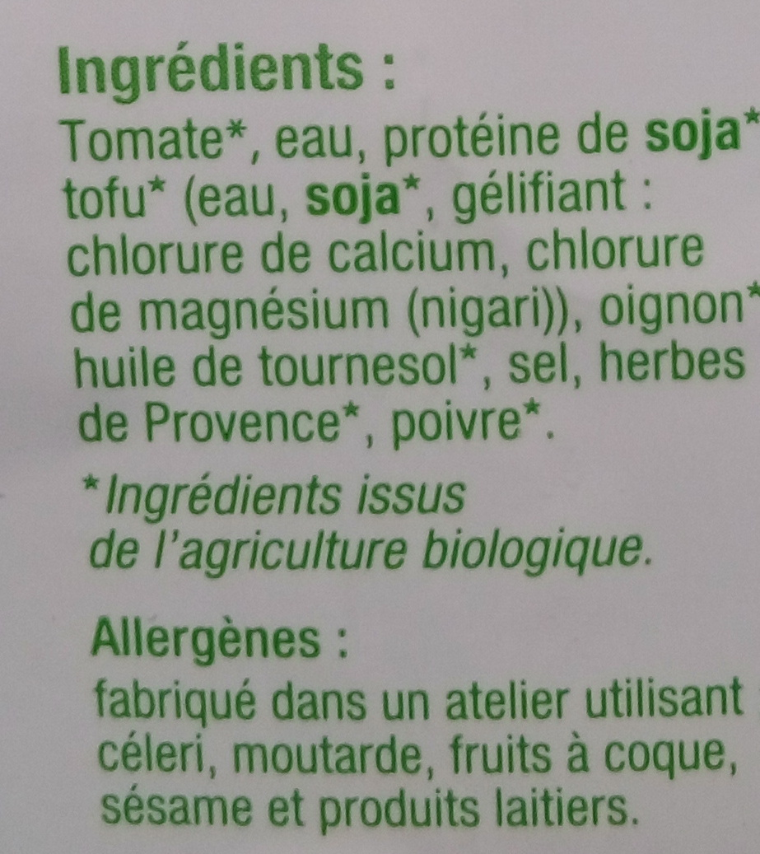

Slide 4

Started in France
More than 80K Products
“A food products database
Made by everyone
For everyone”

Slide 5
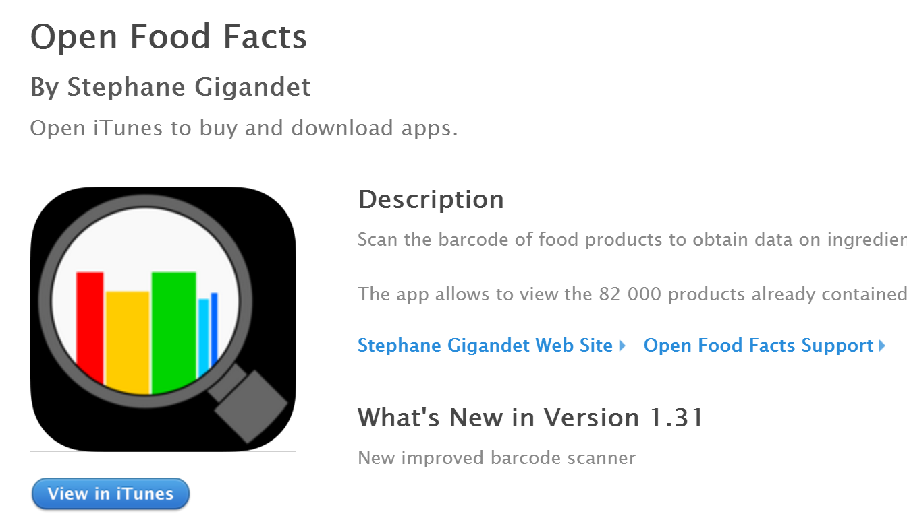

Slide 6
http://fr-en.openfoodfacts.org/product/3483460018247/hache-vegetal-cuisine-a-la-provencale-les-artisans-du-bio

Slide 7
Limitation
Unfriendly Search Engine
No Favorite List

Slide 8
Enhanced Food Explorer
https://jonathanliu.shinyapps.io/FoodExplorer/

